Slide 1

Dsc Frontend Course session 4
Layout & Components & Advanced Fonts
Created by Ahmed Samir

Slide 2
Agenda
Display flex
Advanced fonts
Shadow
Border-radius
Card styling
Landing styling
nav styling

Slide 3
How to design the code
1- reset the style: To remove browser default styles and make styling consistent across all browsers.
* { margin: 0; padding: 0; box-sizing: border-box;}
ul, ol {list-style: none;}
a {text-decoration: none;color: inherit;}
body {font-family: sans-serif;}
You can also use a library like Normalize.css to reset styles safely.

Slide 4
How to design the code
The box-sizing property controls how the total width and height of an element are calculated especially when you add padding and border.
Value | Meaning
content-box | Default. Width/height only apply to the content. Padding and border are added outside.
border-box | Width/height include content + padding + border. Easier to manage layout!
https://developer.mozilla.org/en-US/docs/Web/CSS/box-sizing

Slide 5
How to design the code
2-Global Style: To apply styles across the whole website—like fonts, colors, layout behavior.
Example
:root {
--primary-color: #0ea5e9;
--text-color: #333;
--font-main: 'Poppins', sans-serif;
}
body {
font-family: var(--font-main);
color: var(--text-color);
background-color: #f9f9f9;
line-height: 1.6;
}

Slide 6
How to design the code
3- Custom Style : To style specific elements or components in a unique way.
.button-primary {
background-color: var(--primary-color);
color: white;
padding: 10px 20px;
border: none;
border-radius: 6px;
cursor: pointer;
}

Slide 7
Box Shadow
The box-shadow property in CSS is used to create shadow effects around the outside or inside of an HTML element’s box. It enhances the depth and visual layering of elements, making the UI more appealing.
box-shadow: offset-x offset-y blur-radius spread-radius color inset;

Slide 8
Box Shadow
Parameter | Description
offset-x | Horizontal shadow position (positive → right, negative → left)
offset-y | Vertical shadow position (positive → down, negative → up)
blur-radius | (Optional) How blurry the shadow is (higher = more blur)
spread-radius | (Optional) Size of the shadow (positive = expands, negative = shrinks)
color | (Optional) Shadow color
inset | (Optional) Makes the shadow inside the box instead of outside

Slide 9
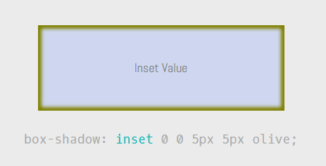
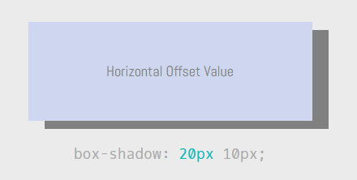
Box Shadow
https://getcssscan.com/css-box-shadow-examples

Slide 10
Text Shadow
The text-shadow property adds shadow to text, helping it stand out, glow, or look 3D depending on how it's used.
text-shadow: offset-x offset-y blur-radius color;

Slide 11
Text Shadow
Parameter | Description
offset-x | Horizontal shadow position (right/left)
offset-y | Vertical shadow position (up/down)
blur-radius | (Optional) How blurry the shadow is
color | (Optional) Shadow color
https://html-css-js.com/css/generator/box-shadow/

Slide 12
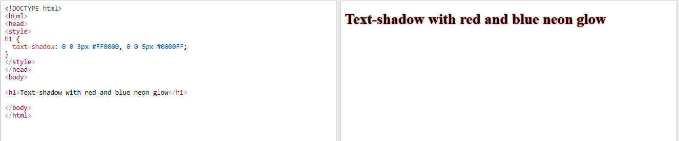
Text Shadow
Example

Slide 13

Linear gradient
linear-gradient() is a CSS function that creates a smooth transition between two or more colors along a straight line.
background: linear-gradient(direction, color1, color2, ...);
background: linear-gradient(to right, red 0%, yellow 50%, green 100%);
Red at the very start
Yellow in the middle
Green at the end
https://cssgradient.io/

Slide 14
Fonts
Property | Description
font-family | Sets the font type (e.g., Arial, 'Roboto', serif).
font-size | Sets the size of the font (e.g., 16px, 1.2rem).
font-weight | Sets how bold the text is (e.g., normal, bold, 400, 700).
font-style | Sets the style of the font (e.g., normal, italic, oblique).
line-height | Controls the spacing between lines of text.
letter-spacing | Controls the space between letters.
word-spacing | Controls the space between words.
text-transform | Changes case (e.g., uppercase, lowercase, capitalize).
font (shorthand) | A shorthand to set multiple font properties in one line.

Slide 15
Fonts plugin
Font awesome Font Awesome
css: all.min.css
Js: all.min.js
Webfonts
Google fonts
Add links from google
And font family property

Slide 16
Overflow & Scroll
Scroll smooth
html {
scroll-behavior: smooth;
}
Over flow
overflow-x: scroll;
overflow-y: hidden;

Slide 17
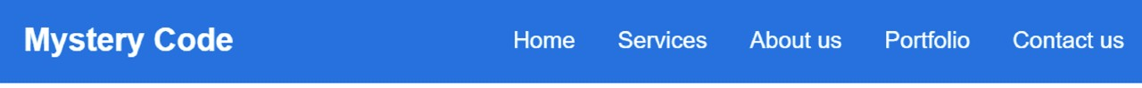
Nav component

Slide 18
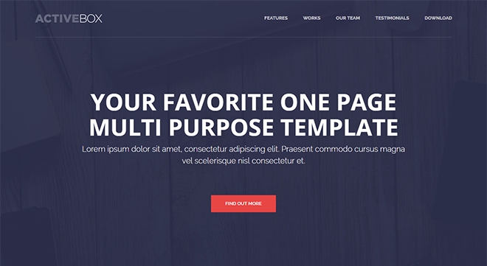
landing

Slide 19
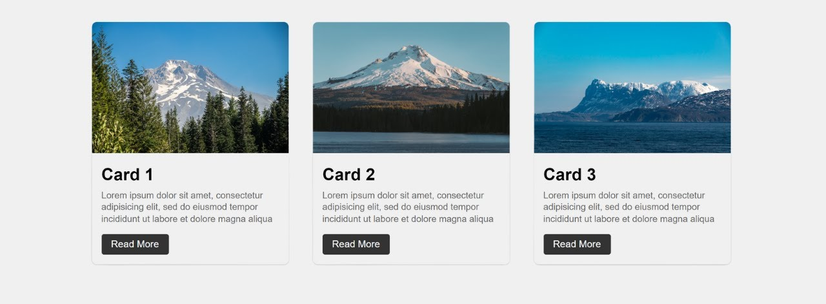
Card Component

Slide 20
Flex box
CSS Flexbox, short for the Flexible Box Layout module, is a powerful layout tool designed to simplify web page layouts by arranging items in rows or columns with ease.
Flexbox eliminates the need for floats or complex positioning, enabling responsive and dynamic layouts.
It aligns items efficiently, distributing space within a container, even when their sizes are dynamic or unknown.
Flexbox is supported in all modern browsers, making it a reliable choice for creating flexible designs.

Slide 21
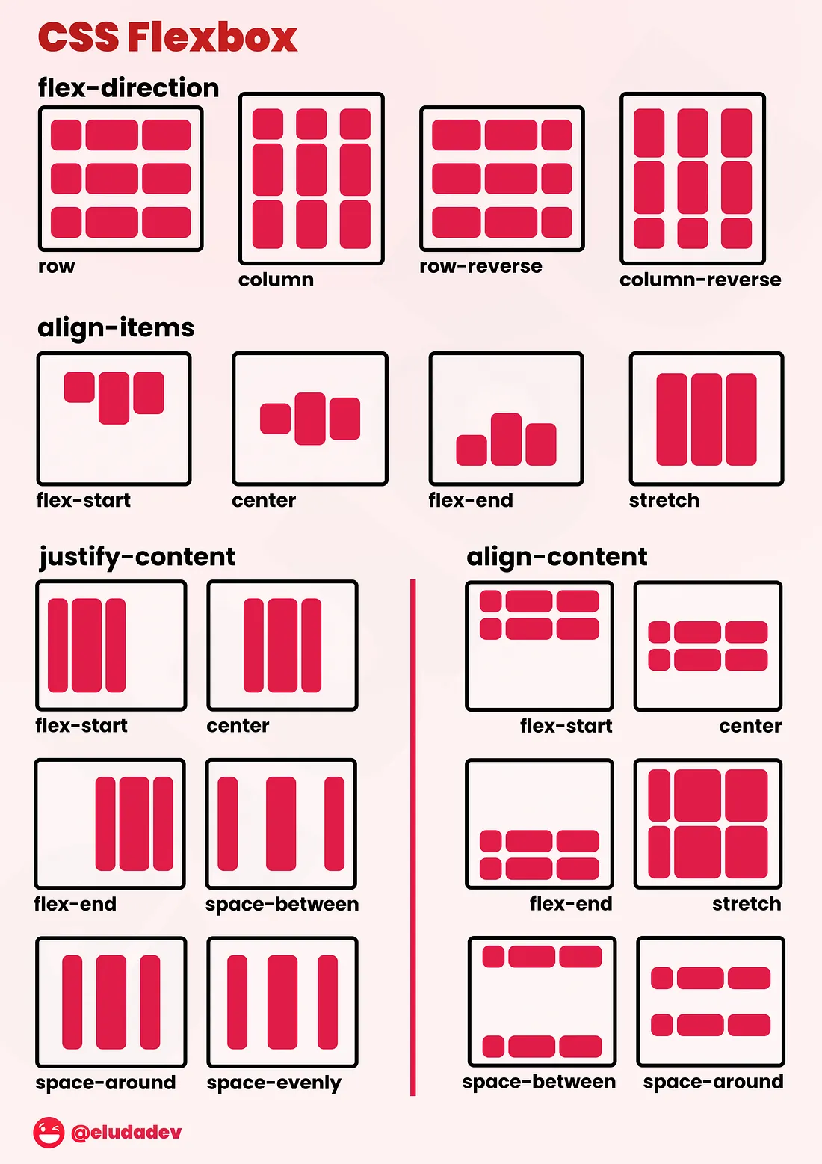
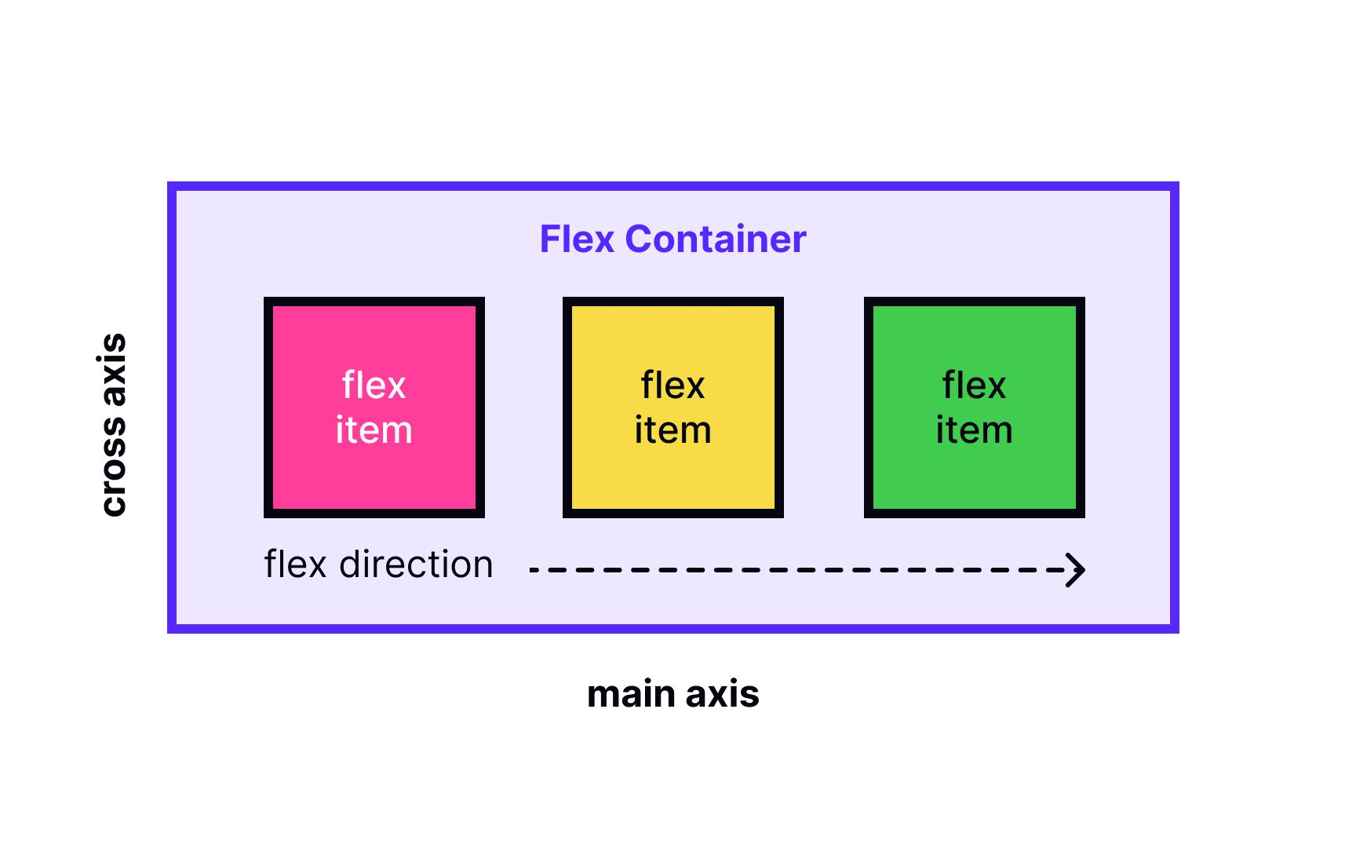
Flex box
https://nouvil.net/flex-box-game/

Slide 22
Flex box
Flex Container Basics
Property | Value | Description
display | flex | Block-level flex container.
 | inline-flex | Inline-level flex container (fits content).
flex-direction | row | Default: Items flow left ➡️ right (main axis = x).
 | row-reverse | Items flow right ➡️ left.
 | column | Items flow top ⬇️ bottom (main axis = y).
 | column-reverse | Items flow bottom ⬆️ top.
flex-wrap | nowrap | Default: all items in one line.
 | wrap | Items wrap onto multiple lines.
 | wrap-reverse | Items wrap in reverse order.
flex-flow | row wrap (example) | Shorthand: flex-direction + flex-wrap.

Slide 23
Flex box
Main & Cross Axis Alignment
Property | Value | Description
justify-content | flex-start | Aligns items to start of main axis.
 | flex-end | Aligns items to end of main axis.
 | center | Centers items on main axis.
 | space-between | Equal space between items.
 | space-around | Equal space around items.
 | space-evenly | Equal space between & outside items.
align-items | stretch | Default: items stretch to fill cross axis.
 | flex-start | Aligns items to start of cross axis.
 | flex-end | Aligns items to end of cross axis.
 | center | Centers items on cross axis.
 | baseline | Aligns based on text baseline.

Slide 24
Flex box
Multi-Line Alignment & Gaps
Property | Value | Description
align-content | stretch | Default. Stretches rows/columns to fill container (only when wrapping).
 | flex-start | Aligns lines to top/left of container.
 | flex-end | Aligns lines to bottom/right.
 | center | Centers rows/columns along cross axis.
 | space-between | Even spacing between wrapped lines.
 | space-around | Even spacing around wrapped lines.
gap | e.g. 10px | Adds space between items (row & column).
row-gap | e.g. 15px | Space between rows of flex items.
column-gap | e.g. 20px | Space between columns of flex items.

